Slide 1
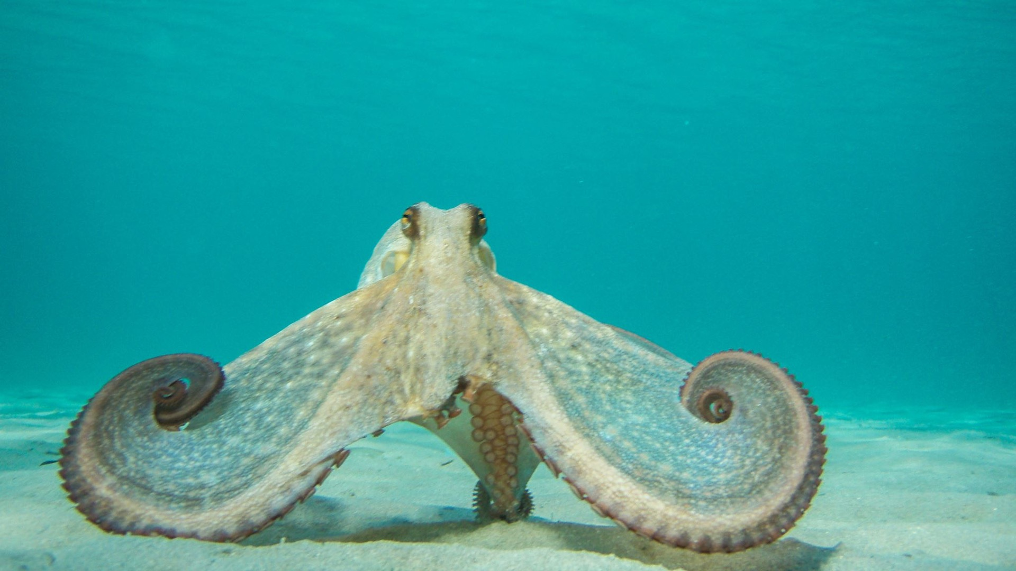
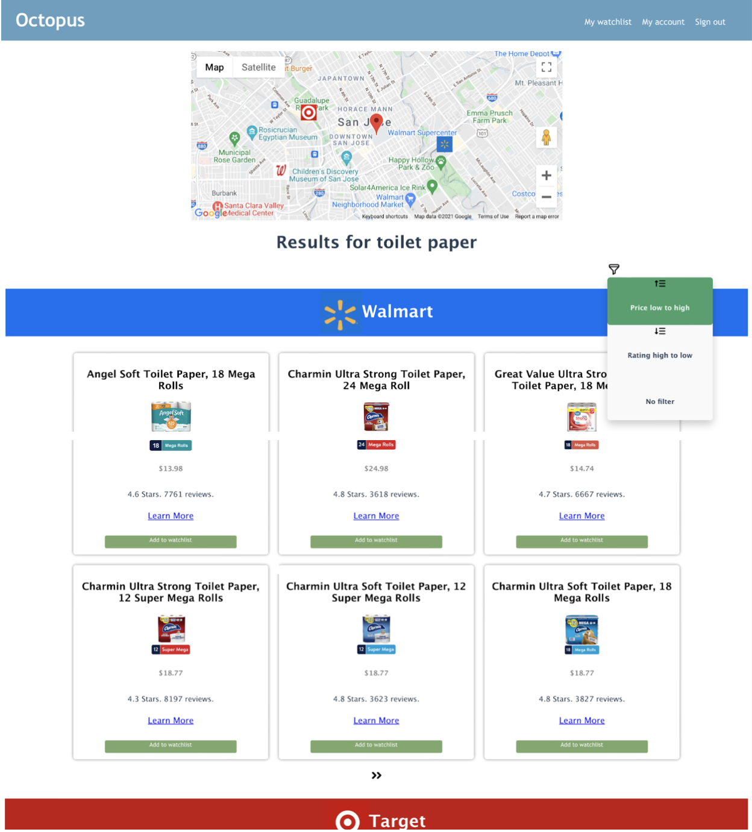
Commodity information integrated recommendation system based on crawler technology and geographic location by Brian Hsu, Xiaohan Jiang, Lei Zhang, Yakun Feng
Octopus
Notes:
Octopus, a Commodity information integrated recommendation system based on crawler technology and geographic location

Slide 2
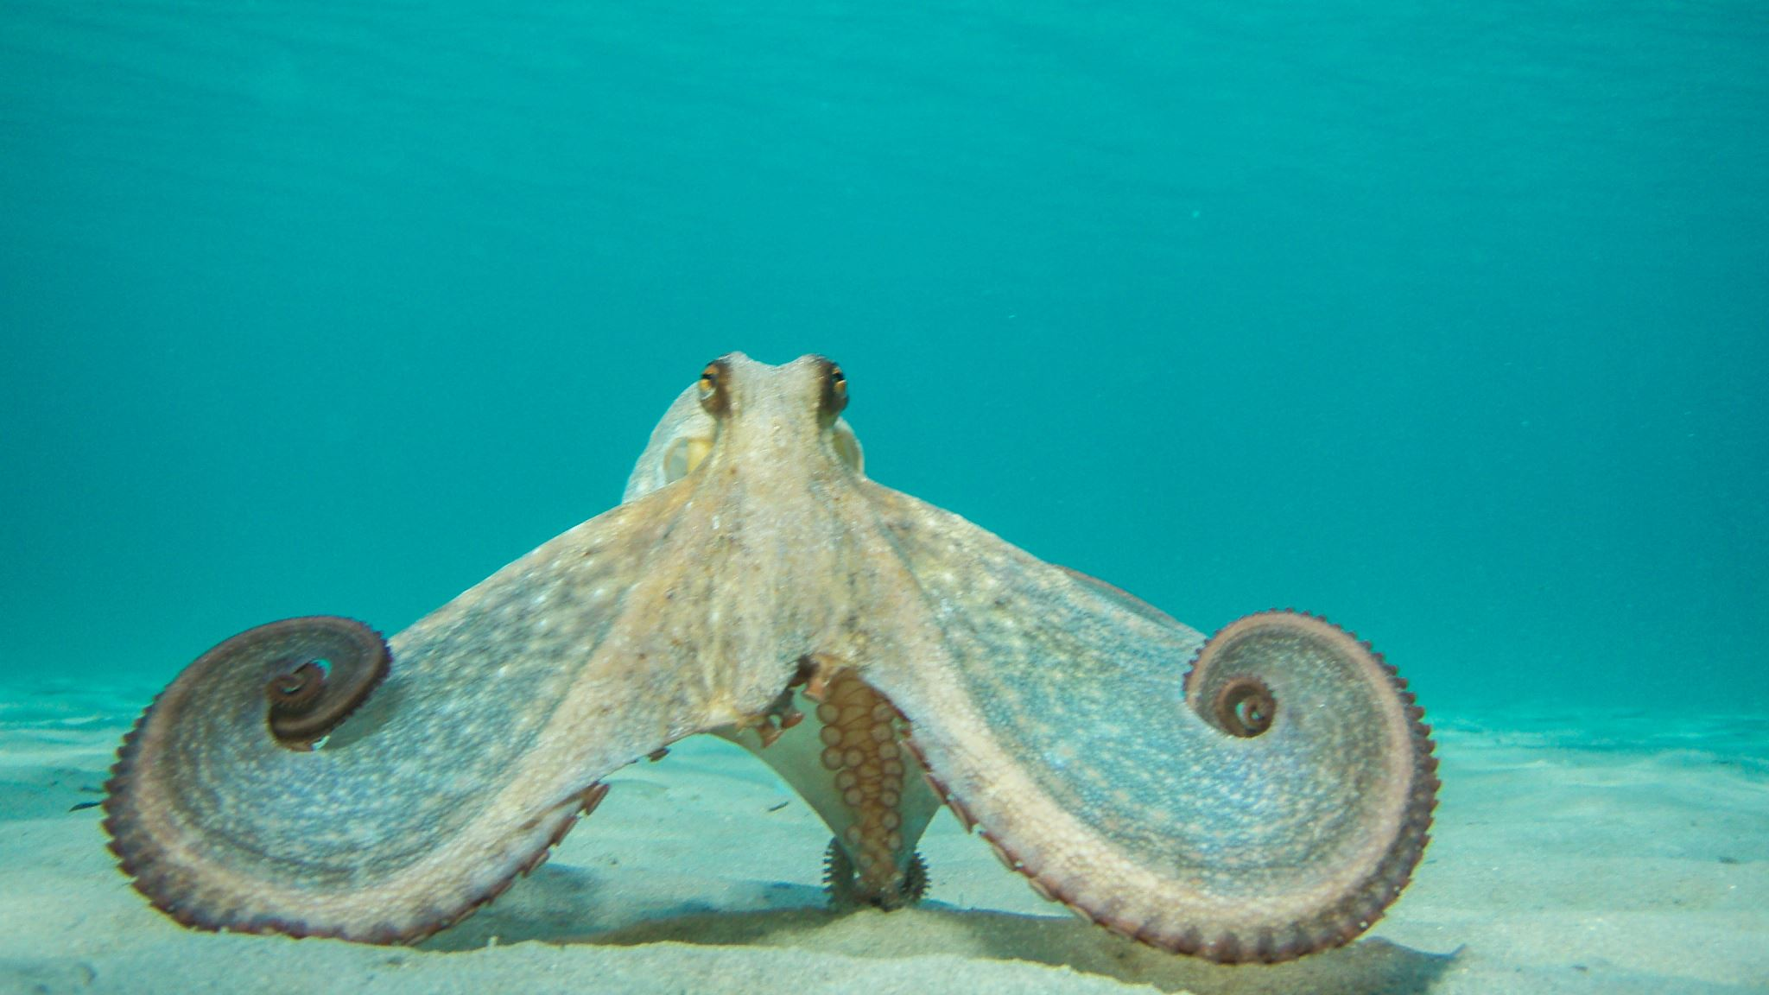
Why Octopus?
Notes:
why Octopus? What problem can it solve?

Slide 3
Why Octopus?
According to Forbes’s report, E-commerce accounts for around 35% of Walmart’s total revenue in 2021, which skyrocketed due to the pandemic.
→ Offline sales account for 65%, , which is still the mainstream shopping style.
(nearly 2 times the amount of the online sales)
Advantages of in-store shopping
- getting products faster
- better guarantee of the product’s quality
Notes:
According to Forbes’s report. The revenue of E-commerce of Walmart skyrocketed due to the pandemic, Despite the fact, in-store shopping is still the main-stream shopping style. Customers prefer in-store shopping not only because they can get the products faster but also have better guarantee of the product’s quality.

Slide 4
Why Octopus?
Due to the pandemic, products such as toilet paper, face mask, and hand sanitizer, are often out of stock.
→ Customers often spend time visiting several stores but cannot get what they need, because they don’t have the inventory information of the stores in advance.
→ Octopus is here to solve this problem!
Notes:
However, due to the pandemic, products such as toilet paper, face mask, and hand sanitizer, are often out of stock, which causes the customers to spend time visiting several stores but cannot get what they need, because they don’t have the inventory information of the stores in advance, and that’s why we need Octopus!

Slide 5
What is Octopus?
Notes:
So, what is Octopus?

Slide 6
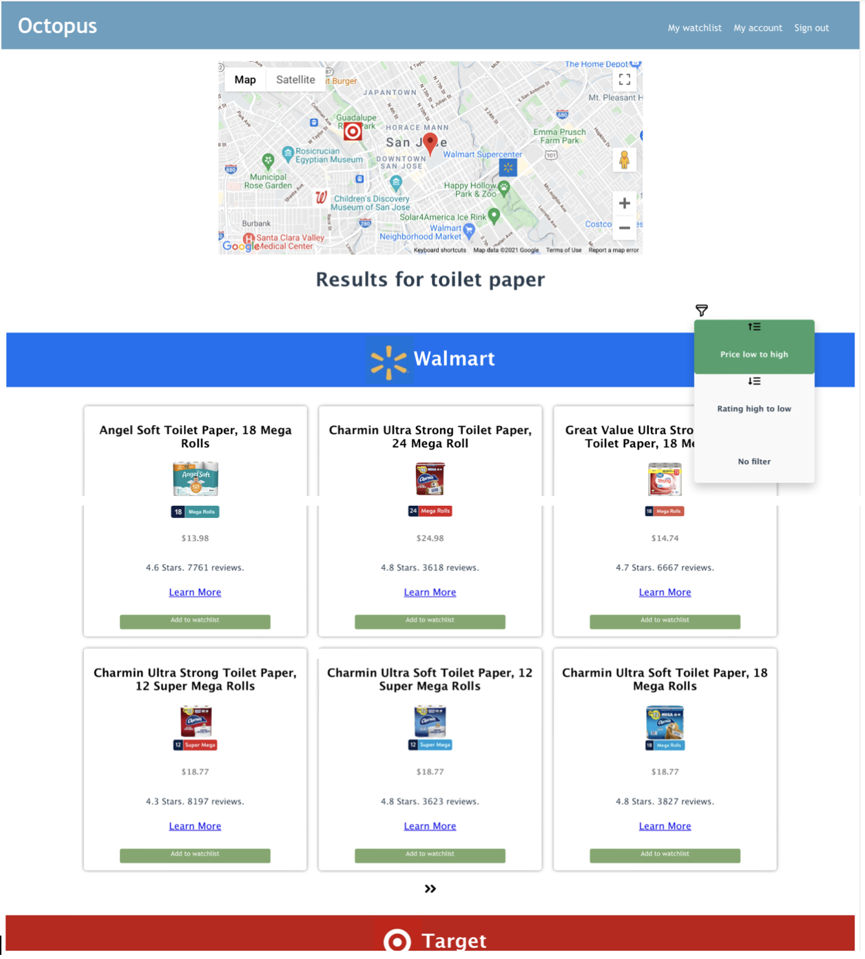
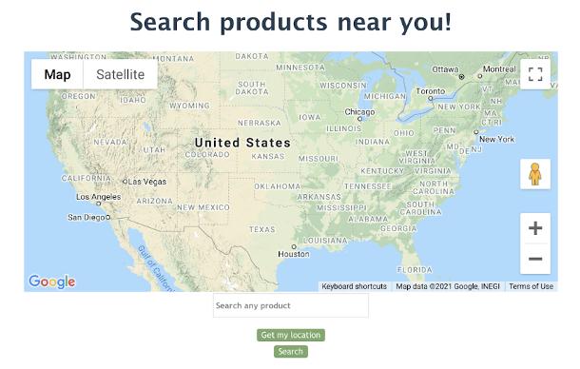
What is Octopus?
Octopus is a web application that utilizes crawler technology to scrape the inventory information in the websites of the stores, i.e., Walmart, Target, and Walgreens, that are near the users, and then integrate the information into one single platform for the users.
Functionalities of Octopus:
- Search product by location and name.
- Stores’ locations shown in map and products’
information shown in listing cards.
- Personal watchlist to keep track of the products.
Search Page
Search Results Page
Notes:
Octopus is a web application that utilizes crawler technology to scrape the inventory information of the stores, i.e., Walmart, Target, and Walgreens, near the users, and then integrate the information into one single platform.
By choosing a location on the map and entering a product name in the search page, users can get the search results including the locations of the stores and the inventory information of the stores in the search results page. Users can also sort the products by price or ratings and add products to their watchlists if something is temporarily out of stock.

Slide 7
The Technology behind Octopus
Notes:
So, what is Octopus?

Slide 8
Workflow of Octopus
Google Search API to get the stores’ websites and locations.
Selenium to get the html content of the websites.
BeautifulSoup to scrape the inventory information in the just obtained html content.
Present the results to the users!

Slide 9
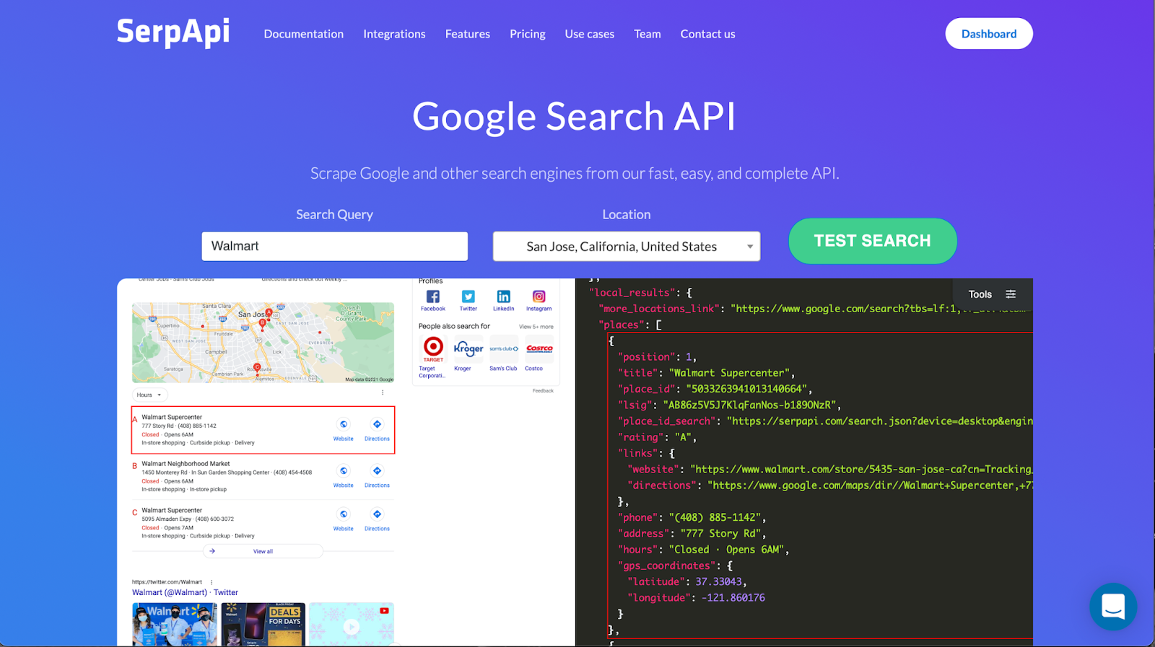
Google Search API (SerpApi)
A normal web scraping method cannot get the results, because Google hides the information.
→ Google Search API is used to get the websites and locations of the stores near the users.

Slide 10
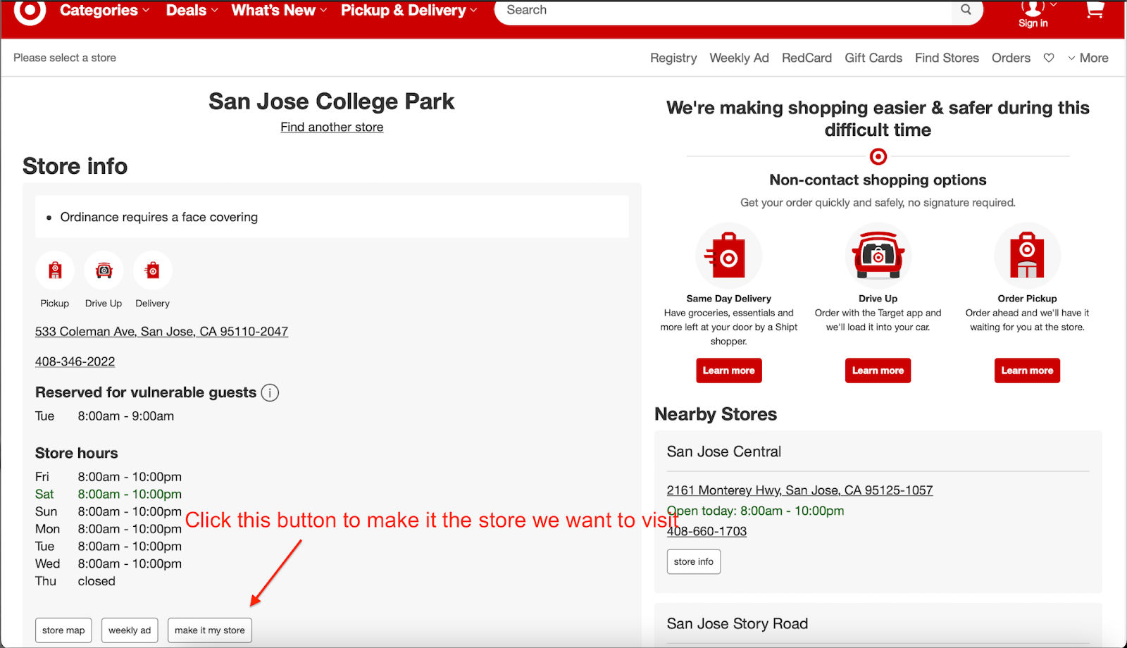
Selenium
To set the store as the store we want to visit, user interactions such as clicking a button is necessary.
→ A library called Selenium can automate the user interactions in the backend.

Slide 11
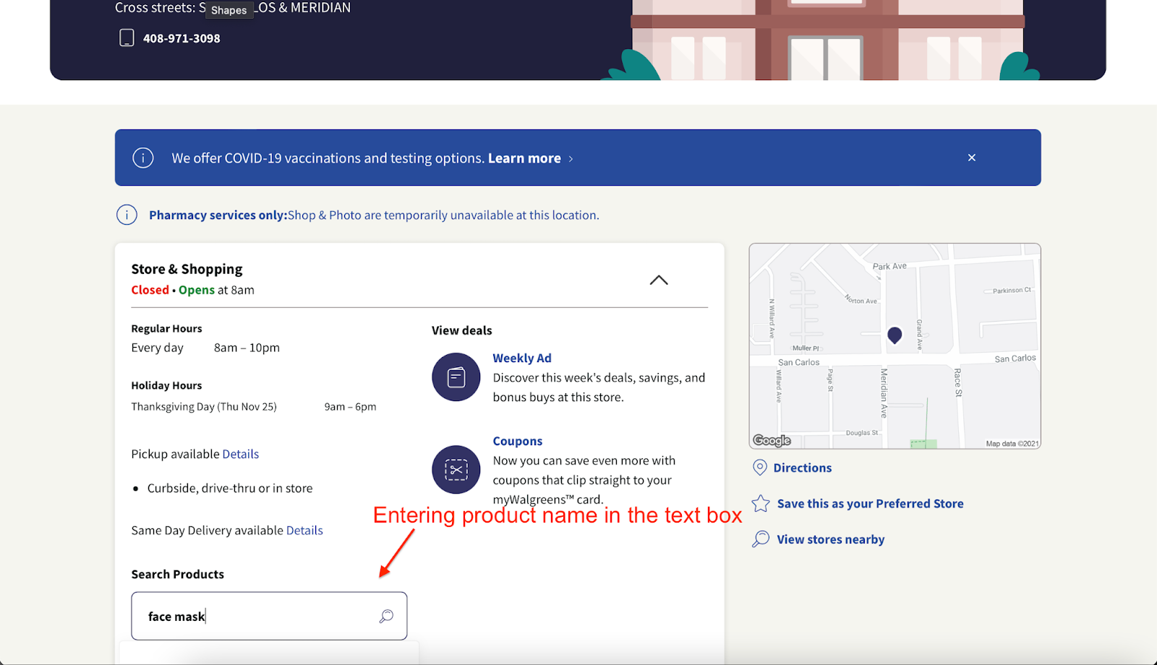
Selenium
To search for a specific product at a specific store, this cannot be done by visiting a URL. Entering text into a search bar is necessary.
→ Use Selenium to automate this user action in the backend.

Slide 12
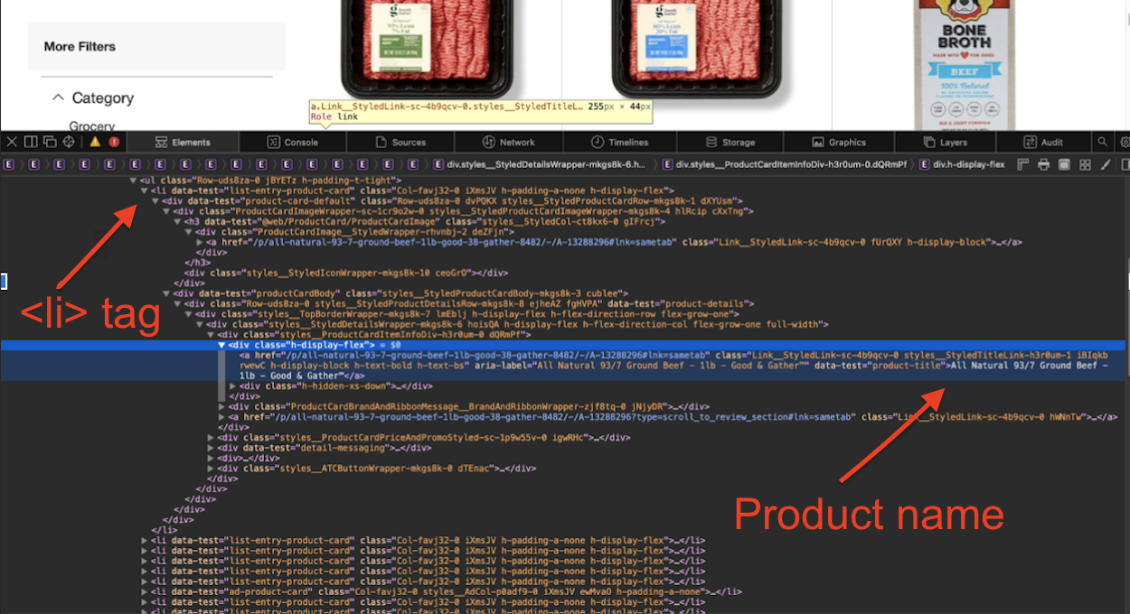
BeautifulSoup
Beautiful Soup is a python library that can scrape anything in the html content visible to us.
Ex: To get the first product name in the web page, tell BeautifulSoup to get the content under the
<div class = “h-display-flex”> tag of the first <li> tag.

Slide 13
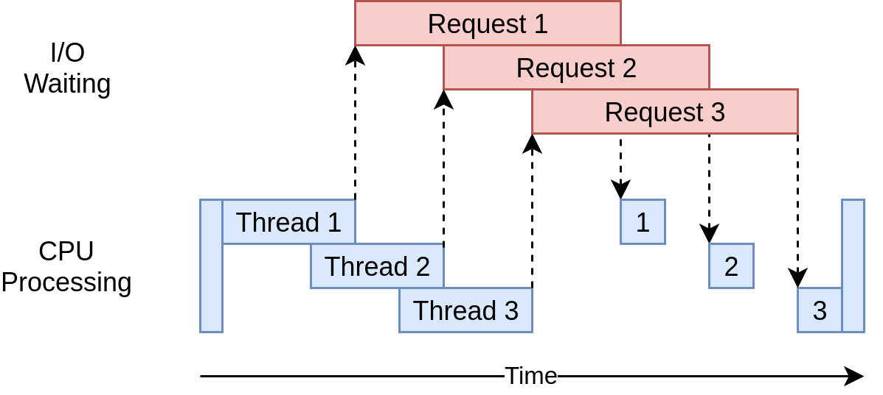
Multithreading
To speed up the above processes,
Multithreading is applied. Each thread
is responsible for one website.

Slide 14
Thank you and welcome to Octopus!
Notes:
Thanks for your time and welcome to Octopus!

